Slide 1


AGE & GENDER DETECTION
AKSSHAT GOVIND
SHREYA SHARMA

Slide 2




Computer Vision
OPEN-CV
CNN
Deep
Learning
#hashtag
Computer Vision
Page1
Computer Vision is the field of study that enables computers to see and identify digital images and videos as a human would. The challenges it faces largely follow from the limited understanding of biological vision.
The process often includes practices like object recognition, video tracking, motion estimation, and image restoration.
Page2
Page3
Page4
Page5

Slide 3



Computer Vision
OPEN-CV
CNN
Deep
Learning
#hashtag
OPEN-CV
Page1
OpenCV is short for Open Source Computer Vision.
This library is capable of processing real-time image and video while also boasting analytical capabilities.
Page2
Page3
OpenCV Functionality:
Image/video I/O, processing, display (core, imgproc, highgui)
Object/feature detection (objdetect, features2d, nonfree)
Geometry-based monocular or stereo computer vision (calib3d, stitching, videostab)
Applications of OpenCV:
face recognition
Automated inspection and surveillance
Vehicle counting on highways along with their speeds
Page4
Page5

Slide 4
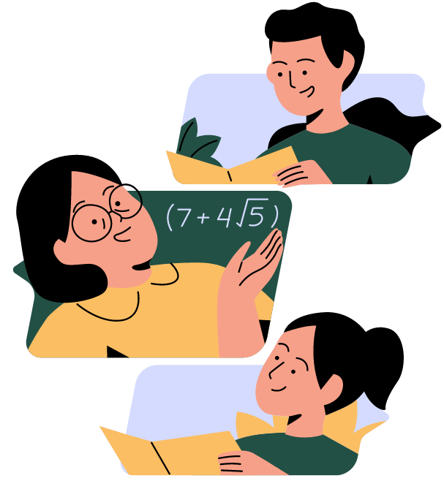
Computer Vision
OPEN-CV
CNN
Deep
Learning
#hashtag
CNN
Page1
Page2
A Convolutional Neural Network is a deep neural network (DNN) widely used for the purposes of image recognition and processing and NLP.
A
Page3
B
A CNN has input and output layers, and multiple hidden layers, many of which are convolutional.
For example, the convolutional network will learn the specific features of cats that differentiate from the dogs so that when we provide input of cats and dogs, it can easily differentiate between the two.
Page4
C
Page5
D
One important feature of Convolutional Neural Network that sets it apart from other Machine Learning algorithms is its ability to pre-process the data by itself.

Slide 5

Computer Vision
OPEN-CV
CNN
Deep
Learning
#hashtag
Deep Learning
Page1
To build a gender and age detector that can approximately guess the gender and age of the person (face) in a picture using Deep Learning on the Adience dataset.
Page2
A
Page3
As Machine learning focuses only on solving real-world problems. Also, it takes few ideas of artificial intelligence. Moreover, machine learning does through the neural networks. That are designed to mimic human decision-making capabilities.
B
Page4
We will use the models trained by Tal Hassner and Gil Levi. The predicted gender may be one of ‘Male’ and ‘Female’, and the predicted age may be one of the following ranges- (0 – 2), (4 – 6), (8 – 12), (15 – 20), (25 – 32), (38 – 43), (48 – 53), (60 – 100).
Page5
C

Slide 6

Pre-Requisites
Objectives
TensorFlow
Models
#hashtag
Pre-Requisites
Page1
Page2
Install OPEN-CV
Install an IDE or using Google Collab
The Dataset
Page3
You’ll need to install OpenCV (cv2) to be able to run this project. You can do this with-
We’ll use the Adience dataset. It has a total of 26,580 photos of 2,284 subjects in eight age ranges and is about 1GB in size. The models we will use have been trained on this dataset.
Page4
Page5

Slide 7

Pre-Requisites
Objectives
TensorFlow
Models
#hashtag
Objectives
Page1
Page2
Detect faces
Page3
Classify into Male/Female
What can we expect from this software?
Classify into one of the 8 age ranges
Page4
Put the results on the image and display it
Page5

Slide 8

Pre-Requisites
Objectives
TensorFlow
Models
#hashtag
TensorFlow
Models
Page1
Installing these files pre-handed
Page2
age_deploy.prototxt
age_net.caffemodel
Page3
opencv_face_detector.pbtxt
opencv_face_detector_uint8.pb
Page4
gender_deploy.prototxt
gender_net.caffemodel
Page5

Slide 9




Technical
Learnings
#hashtag
Technical
Learnings
Page1
Page2
Using certain libraries and packages for computer vision techniques.
• Adience Dataset
• Caffe Models
• Protobuf File (protocol buffer)
Page3
Page4
Getting started with Python Programming
Objects, Data and Methods.
Conditionals and Loops.
• Contour creation and mapping.
• Feature extraction
Page5

Slide 10
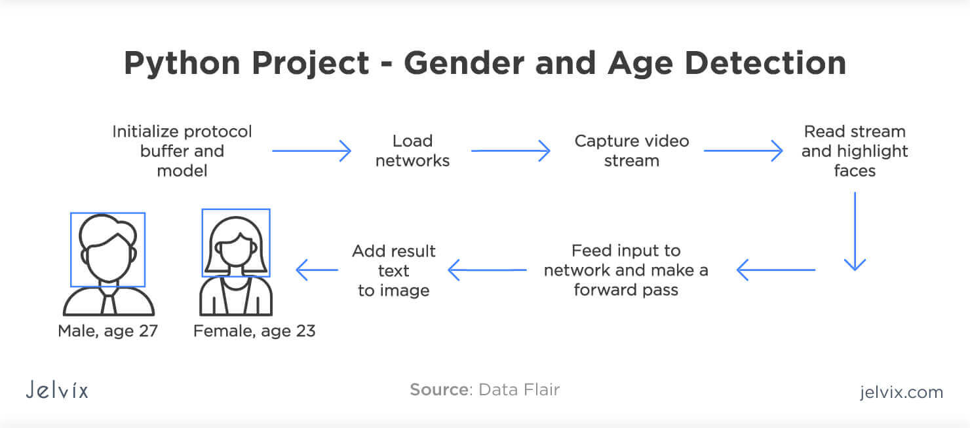
PROTOTYPE
PROTOTYPE
PROTOTYPE
PROTOTYPE
#hashtag
PROTOTYPE
Page1
Page2
AGE and GENDER Detection System
Page3
Page4
Page5

Slide 11
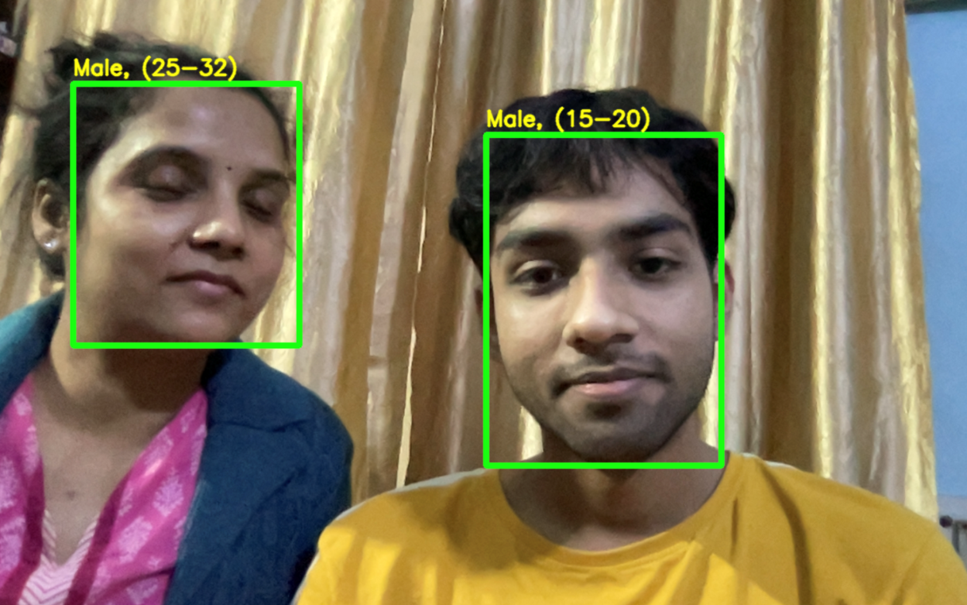
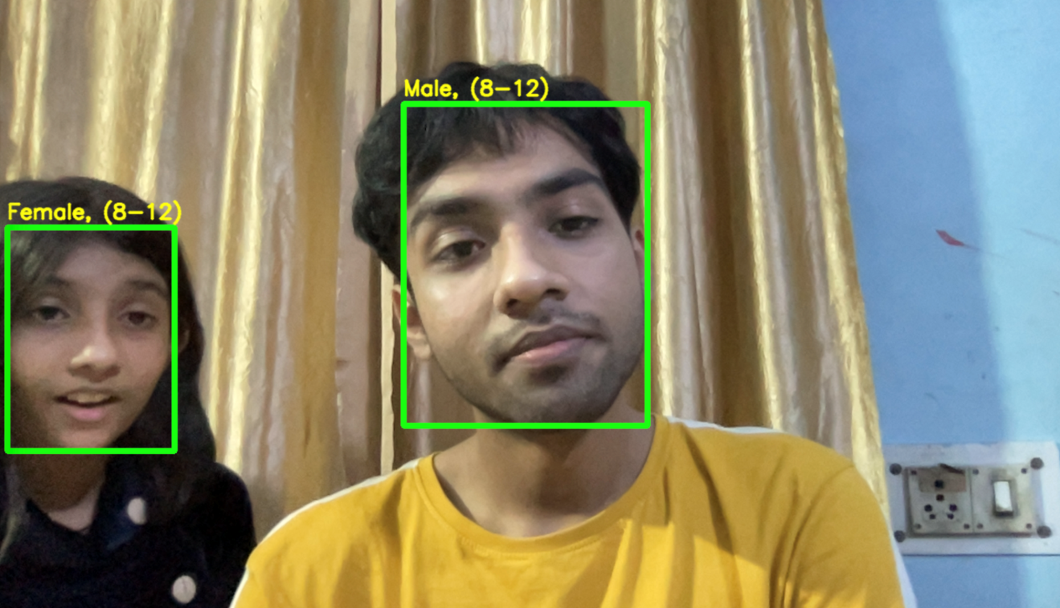
PROTOTYPE
PROTOTYPE
PROTOTYPE
PROTOTYPE
#hashtag
PROTOTYPE
Page1
Page2
Page3
Page4
Page5

Slide 12
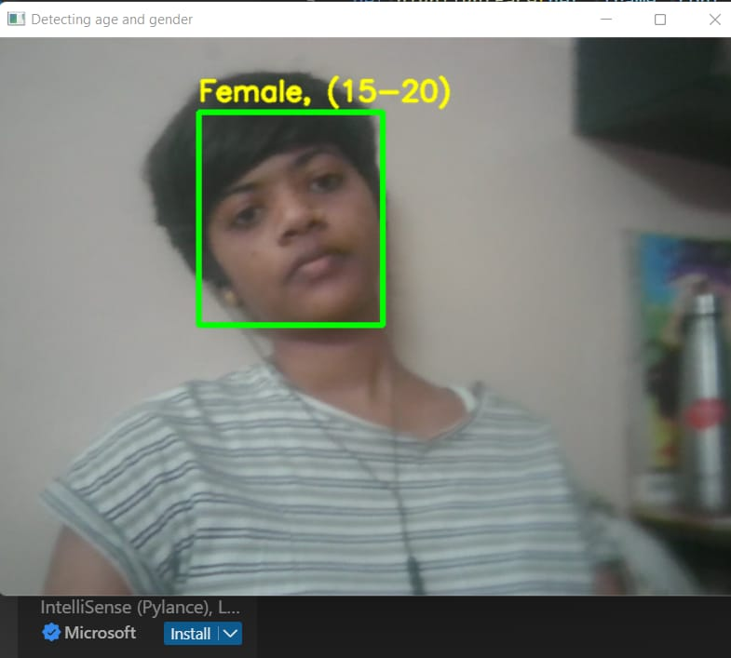
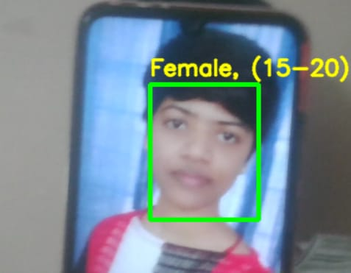

PROTOTYPE
PROTOTYPE
PROTOTYPE
PROTOTYPE
#hashtag
PROTOTYPE
Page1
Page2
Page3
Page4
Page5

Slide 13

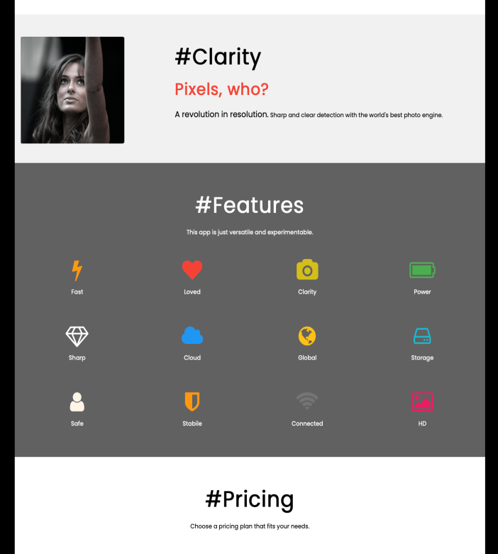
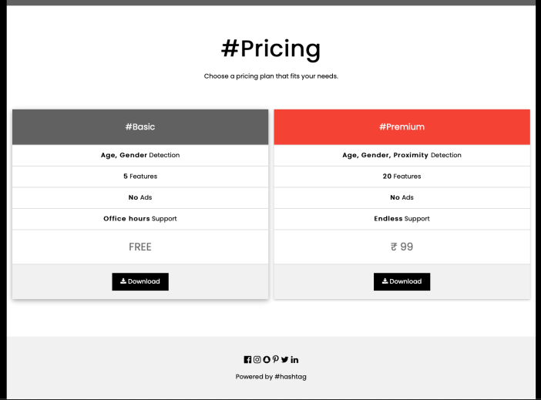
PROTOTYPE
PROTOTYPE
PROTOTYPE
PROTOTYPE
#hashtag
PROTOTYPE
Page1
Page2
Page3
Page4
Page5

Slide 14




Outcome
Future
Scope
#hashtag
Outcome
Page1
Page2
Throughout the course of this Internship, we were able to learn a great deal of skills that helped us in creating a working model of Age & Gender Detection System
We also learned how to work collectively as a team and divide and executed the tasks in such a manner that we were able to deliver this project in the given time limit.
Page3
And were also able to learn various other skills as well such as how to read, analyse various models and datasets.
The project facilitates any user to successfully identify and locate a person in an image or video and predict their gender and age.
Page4
Page5

Slide 15
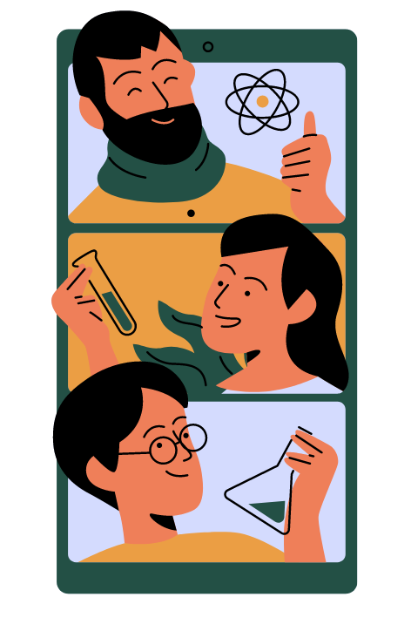

Outcome
Future
Scope
#hashtag
Future
Scope
Page1
Our Detection System can be enhanced and altered as per the users needs and is completely scalable as per the size of the data generated by the organization whether it is big or small which helps it to adapt to the size of the operation it has to execute and helps benefit all kinds of businesses whether big or small.
Page2
A
Page3
The Age & Gender Detection Extension created by our team can be put into use in the existing buildings and stations, especially the smaller ones which cannot afford the really expensive management systems
Page4
B
Page5
C
It is the most cost-effective system we can think of and can be used for the benefit of the customers.

Slide 16
Thankyou
Any Question?

